Slide 1
Introduction to Databases July 2022

Slide 2
Roadmap
Conceptual overview of databases
Big picture of database design
Learn basic SQL queries with Harry Potter database
How data analysts use databases: Steven Zhang

Slide 3
Setup
Install DB Browser for SQLite
Download standard installer for 64-bit Windows

Slide 4
Learning Objectives
Appreciate the value of databases
Differentiate the use of a spreadsheet and a database
Describe the steps involved in database design
Write SQL queries to utilize data

Slide 5
What is a database?
A database is a collection of data/information that is organized in a certain structure for management and access
A database management system (DBMS) is a software or interface designed to manage or access the database.
Microsoft
Notes:
Microsoft – collection of interrelated information, used to store and organize data so that it’s eaier to manage and access
A database can be displayed in a tabular structure just like a spreadsheet, but can do more than that because we can create relationships across the tables. It can also handle multiple data types – including images, calendars, etc.
These relationships allow for a more flexible and productive use of data.

Slide 6
Types of databases
Relational databases
Data is stored in tables (rows/cols) and are related to each other.
Popular products: MySQL, PostgreSQL, Oracle, SQLite, Airtable
Main programming language: SQL
Non-relational database
Data can be stored using key-value pairs, JSON, graphs, etc.
Popular products: MongoDB, Redis
Notes:
There are two main types of databases.
The first one is relational databases, which we will look at today. Data is stored in tables (meaning in a row and column structure), and from the name, these tables are interconnected or related to each other somehow.
Traditionally, ones uses database management systems like MySQL that engineers created to access these databases. A DBMS is an interface between the database and its end users, allowing users to retrieve, update, and manage how information is organized and optimized.
With cloud computing, there are newer people in the game like Airtable.
2. Another database that is growing in popularity is non-relational database. It’s more flexible than relational databases because you don’t have to impose a certain structure. Data is also not stored in tables, as relational databases do. Rather they are stored in its optimal structure based on the data type such as key-value pairs or JSON. It’s also known as NoSQL – can use multiple query languages such as C, Java, PHP, Python, etc.
How do you decide what to use? Really depends on the size of the database and the flexibility that you will need..

Slide 7
Question
What are some databases you commonly use or interact with?

Slide 8
Examples of databases
Netflix
Bank
SaveOn Sales data → Cris
Emissions data → Yasi, Valentina
Notes:
Netlifx keeps track about which shows and movies are available and your viewing preferences
Your bank has use database to track global daily transactions, customer accounts, balances, and deposits
Retail stores use databases to store prices, customer information, sales information, inventory, etc.
Amazon – use some sort of database to organize products, pricing, customer information, purchase history

Slide 9
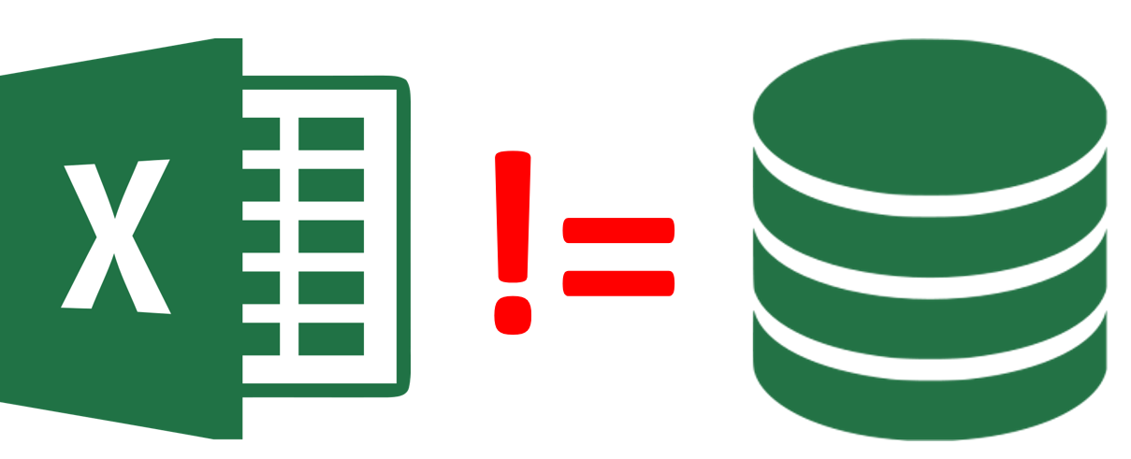
Database vs. spreadsheet
One of the main important technical difference between a database and a spreadsheet is how they store data.
In a spreadsheet, data is stored in cells. You can format, edit, and manipulate data within that cell.
Designed for one user
In a database, cells contain data that come from external tables. If you change a record in one place, it will make the change in all other places that references that record.
Can handle more complex information
Notes:
Krisha, if we can store data in a spreadsheet, why use a database? That is a great question.
Many times and as in your GP, your site supervisor stores all their data in a spreadsheet and calls it their “database.” In many ways while it acts as their database, it’s not really a database database. It’s a spreadsheet.
In a spreadsheet, data is stored in a cell, and can be formatted, edited, and manipulated within that cell. Yes you can link cells together and use formulas, but if you make a change it’s very manual.
In a database, cells contain data that come from different tables. If you change a record in one table, all other tables that reference that cell change as well.
Spreadsheets were originally designed for one user, and their characteristics reflect that. They’re great for a single user or small number of users who don’t need to do a lot of incredibly complicated data manipulation. Databases, on the other hand, are designed to hold much larger collections of organized information—massive amounts, sometimes. Databases allow multiple users at the same time to quickly and securely access and query the data using highly complex logic and language.
The database usually serves as “the source of truth” because only certain people can actually edit it. Unlike spreadsheets for example. So when you download the data from the database and manipulate it, it likely won’t
Think about it this way. Let’s say you are a company and you are operating like a spreadsheet. If one of your customers change their email address, you would have to notify sales, marketing, fulfillment that customer X changed their email address. But instead if you are operating like a database, you just make the change in one location, and everyone knows right away that customer X changed their email address.

Slide 10
Why use a database?
Size of data
Multiple users updating data
Redundancy of data
Data accessibility and speed
Notes:
Spreadsheets are great, and many times in your career you will see that Excel is enough. People are familiar with Excel or Google sheets. However, there are drawbacks to spreadsheets too.
Jourean had to redo her whole analysis because the data is a lot! Excel keeps crashing.
Same with Ning’s right?
Spreadsheets were first created for data storage and calculation. The advantage of using spreadsheet is that you can see all your data right away. This comes at a cost though. You can’t really deal with large volumes of data. Once you hit a million plus rows, it slows down a lot and you end up having multiple spreadsheets and then the troubles come.
Another benefit of databases is that it allows multiple users to edit or query the database in real-time. This is not always the case with spreadsheets. One person can’t open 2 excel files at the same time. The workaround is to use Excel in One Drive or Google Drive, but some features of Excel Desktop is not available in those settings. At the same time, different data users can have different access to data. For example, only HR and the employee in consideration can see salaries, but you can’t see the salary of other colleagues.
You also get a lot of redundant information, which we will see more of later. Because tables in databases are linked together, there is little to no duplication of source data. If you make a change in one location, all other cells that reference that location is changed. Whereas this is not the case in spreadsheets. A database can eliminate the problem of having numerous spreadsheets containing similar data and maintaining different copies of spreadsheets for version control.
Importance – crash or disconnect and lose 5 min of data
If you were to look for one particular row in Excel how would you do it? Filter based on values on the column or ctrl find – not the fastest if you have a large spreadsheet. A database can quickly retrieve all records that match a certain criteria and cross refrences records in multiple tables too.
Spreadsheets work but have you tried editing one cell and then the whole spreadsheet stop working/errors throughout? For example, you are fixing an interconnected formula and one false move and all your sheets throw out errors.

Slide 11
Limits of Excel
Fetzer and Graeber (2021)
“Conservative estimates suggest that the failure of timely contact tracing due to the data glitch is associated with more than 125,000 additional infections and over 1,500 additional COVID-19-related deaths. Our findings provide strong quasi-experimental evidence for the effectiveness of contact tracing.”
Notes:
Here’s a real life example of the limits of spreadsheets/Excel.
Excel cannot exceed the limit of 1,048,576 rows and 16,384 columns.
Access limits: 2gb and 255 columns only

Slide 12
How to decide?
What kind of data do you have?
How do you want to use that data?
How important is data integrity?
Do you need deep search capabilities?
How many people need access?
Notes:
Most spreadsheets allow text and numeric data, but not necessarily other types of content such as images, videos, and documents. Databases, on the other hand, accommodate a wide range of file types and larger files sizes.
If you want to track a limited volume of data and apply formulas, a spreadsheet is likely your best bet. But if you’re looking to isolate certain subsets of data at a time, or arrange data into multiple views, a database is more effective.
A spreadsheet will, by default, allow you to type anything into a field—and even store different types of data in the same field. This allows for a lot of flexibility, but can also create problems when you (or a teammate) makes a mistake. Databases offer built-in data validation. If you try to input something in the wrong format, you’ll get an error. This keeps the integrity of your data intact, preventing data cleanliness issues down the line.
Spreadsheets have limited filtering and searching capability—so if that’s compatible with your use case, it could be the right choice. If you need to retrieve records quickly using a certain set of parameters, a database might be a better choice.
It’s easy to share a spreadsheet. You can send a link, cloud share, or even print it out. But sharing is very different from collaborating. Spreadsheets aren’t great for the latter. Databases are designed for collaboration between multiple users. Say, for example your organization uses one central pool of data for multiple end-uses. Databases let you update information in one place without having to update the data in all the downstream locations it’s tied to. They serve as a single source of truth.

Slide 13
Roadmap
Conceptual Overview of Databases
Big picture of database design
Learn basic SQL queries with Harry Potter Database
How data analysts use databases: Steven Zhang

Slide 14
Relational databases
Data is organized in a tabular structure
Rows are called “records” or “tuples”
Columns are called “fields” or “attributes”
Data is linked or related to each other using keys
Structured Query Language (SQL) is a standard programming language to define, manipulate, and query relational databases
Notes:
As I mentioned earlier, we will focus on relational databases. And in relational databases, data is organized in a tabular structured and are interconnected to each other.
A table is a grid of rows and columns that store data. Rows are called records/tuples and are individual entries in the table. The columns are called fields/attributes and are the values of a table.
Remember we mentioned earlier that databases can store up to millions of data. So how do we get one particular data spread across different tables to display to the user? It is in using keys – and we’ll talk about PK and FK in a bit.
SQL is the standard programming language to query relational databases, so we will learn some basics. We will implement this using SQLite, but the syntax is almost the same across different products.

Slide 15
Database design
Requirement Analysis
Discuss with users what they want from the database
Conceptual Database Design
Design a high-level overview and description of your database
Can use diagrams such as the Entity-Relationship model
Logical Database Design
Operationalize conceptual design in a database management system
Notes:
From a very high level point of view, there are 3 steps to designing a database
User requirement
Who will use it? What will they use it for? What type of data will be stored?
The owners wanted to manage the relationships with their clients, know when to follow up to drive their sales, input info during checkin, forecast when they should followup.
Now their current excel spreadsheet is fine but it grows exponentially over time and would be harder to manage.
This process usually entails discussions with the user groups – project managers, data entry clerk, data analysts
What will the database be used for? Generating reports? Creating an app on top of it?
Is it a brand new database? Will you have to migrate data from somewhere else?
Conceptual Database Design
In this second step, you create a simple description of the data that closely matches how users and developers think of the data
Think about how the data will be stored
How they are related to each other
Diagrams
Meetings to just draw things out, think about different types of tables, how to connect each table together
Logical database design
Now you convert your database design into a database schema itself in a database management system, like SQLite, which we will do later on.
And of course this process can be recursive. It’s not a linear process.
Of course there are more steps here, thinking about performance, or security, etc.

Slide 16
Database design
Entities are real world objects that you want to include in your database.
Attributes are characteristics that describe the entity.
Designing a database can be an iterative process.
If you are a small grocery owner and want to create a database, what entities would you include? What would be the attributes in those entities?
Notes:
Entities are real world objects that can be distinguishable from other objects. It usually maps to a table in your database.
For example, if you have a small grocery store and want to create a database -- entities could include Customers, Products, Inventories,
An entity is best described using attributes. For example, the Customer entity would have name, email address, mobile number, delivery address as attributes.
What do you think would be attributes of the Products Entity? Product information, selling price, purchase price, quantity
When you design a database, sometimes the choice of entities is not entirely obvious. It can be a iterative process.

Slide 17

Database design
A schema represents the blueprint/structure/configuration of your database
Customers(cust_id: integer, last_name: varchar, first_name: varchar, email: varchar, address: varchar, mobile_num: integer)
cust_id | first_name | last_name | email | address | mobile_num
1 | Olivier | Ntwali | olivier@mfre.com | Vancouver, BC | 6041234567
2 | Krisha | Lim | krisha@mfre.com | Vancouver, BC | 7781234567
Notes:
In a relational model, the schema for a table specifies its name, the name of each column or attribute or field, and the type of each field.
As an example, customer data in a database may be stored in the following schema. This means that each record in the Customers table has 6 fields (customer id, last name, first name, email, address, mobile number), with field names and types as indicated.
Each row in this Customers table is a record that describes the customer. Every row follows this schema of the Customers relation.

Slide 18

Case study: Harry Potter
How many movies have you watched?
Notes:
To make our discussion about databases a bit more concrete, and to walk you through some steps in designing a database, we will have a case study. And we decided it’ll be about Harry Potter. Do we have Harry Potter fans here?
Let’s watch the trailer of the first movie.

Slide 19
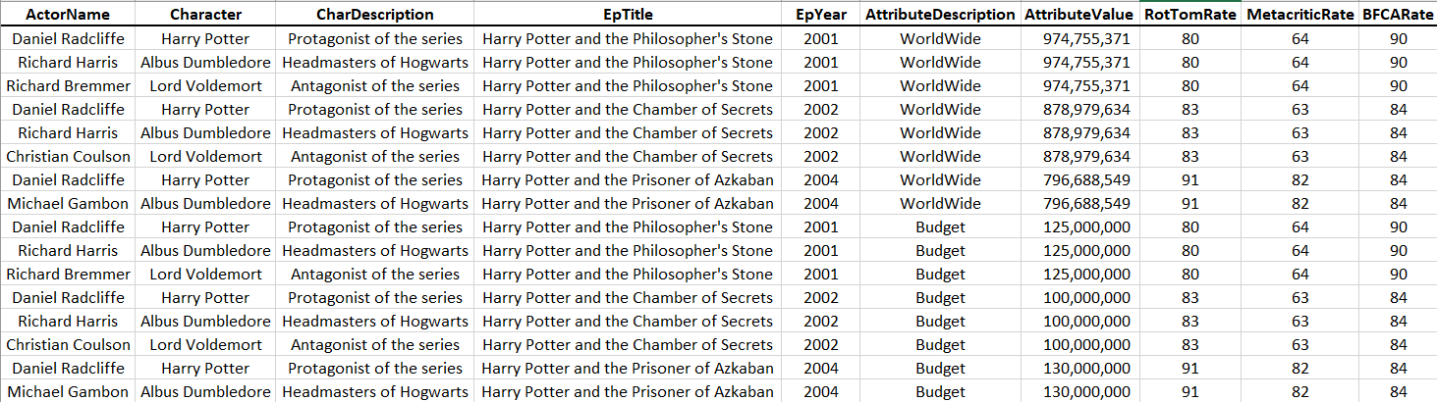
Sample database
Let’s say I want to keep track about the cast, box office sales, and ratings of the Harry Potter movie franchise.
We might start with a spreadsheet.
Notes:
Honestly, I am just learning about the Harry Potter world. I am just on the third book. Dr. Vercammen gave me idea to create a database of actors, ratings, and box offices sales of the Harry Potter movie series as a mini project to learn about databases and SQL. And honestly, mini projects like these are the best ways to learn anything about programming – whether it’s R or Python or SQL. Working with small data is good because you can understand what the code is doing, and once you get the syntax (a set of rules of a language) then it is easily transferrable to bigger datasets).
Let’s say I have no idea yet about how to create an actual database using a database management system. My go to would be to use Excel, which is what many of you have used in your GP.
Because I want to keep track about the cast, box office sales, and ratings, this spreadsheet over here would probably be what I would start out with.
Notice that the data on your screen right now is just for 3 characters – Harry Potter, Dumbledore, and Lord Voldemort.
Do you notice anything from here? What are potential issues from this structure of databases?
- Redundancy

Slide 20
Issues
Updating data – have to update 3 rows instead of 1
Notes:
Here are some issues – and again adding motivation to using a database instead.
Updating data requires modifications of multiple rows. For example, what if the rotten tomato rating for the philosopher’s movie is actually 85 and not 80? Then you would have to update 3 rows instead of 1.

Slide 21
Issues
Deleting data – if we delete Richard Bremmer, we delete the character Lord Voldemort in the first movie.
Notes:
If we delete that Richard Bremmer acts in the Philosopher’s Stone episode, then we delete the character Lord Voldemort in the first movie.
One way to deal to this with this situation is to create separate entities or tables and then link them together using keys/relationships.

Slide 22
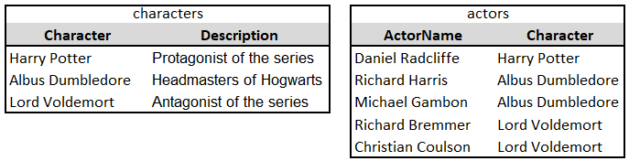
actors
To avoid some of the issues discussed, it may make sense to break the first 3 columns of the data into 2 entities.
Notes:
Specifically, it would make sense to break the first three columns into 2 entities. One for characters and one for actors.
Why? Repetition of description. If we have to change the description, we just change it in the characters table and when we join these 2 tables later on then the change is automatically reflected.
Whereas if we stored it in the spreadsheet format earlier, we have to change the description over multiple rows. Might be easy with Ctrl H in our example because we only have a few rows, but it is not the most efficient when we have millions of rows.

Slide 23
What other entities should we have?

Slide 24
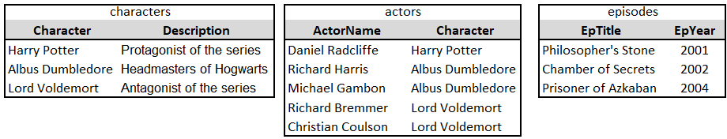
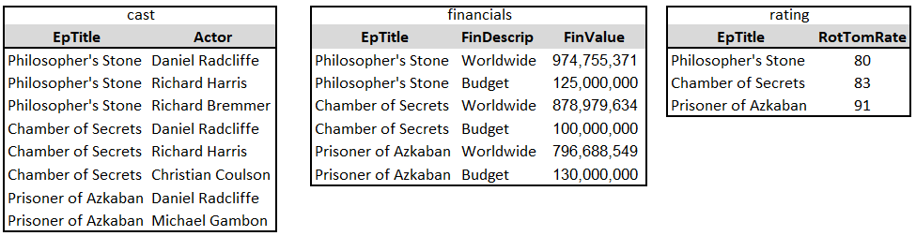
entities
Notes:
What if we misspelled the episode title though? Or that the title should actually be
“Harry Potter and the Philospher’s Stone”, “Harry Potter and the Chamber of Secrets”, “Harry Potter and the Prisoner of Azkaban”
We’ll have to change the title in 4 different tables!
It's often preferable to make sure that a particular column of data is only stored in a single location, so there are fewer places to update and less risk of having different data in different places. If we do that, we need to make sure we have a way to relate the data across the tables, which we'll get to later.
Or what if there are two different Michael Gambon in the world (actor name) and they were somehow casted for different positions? We can’t really rely on a name to look up the cast.

Slide 25
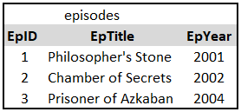
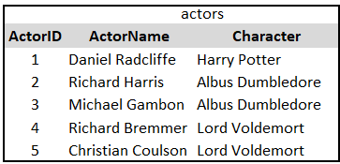
Using IDs
Another improvement will be to add ID’s
So if we have to change the episode titles, we only have to do it in 1 table instead of 4 tables → less risk of having different data in different tables.

Slide 26
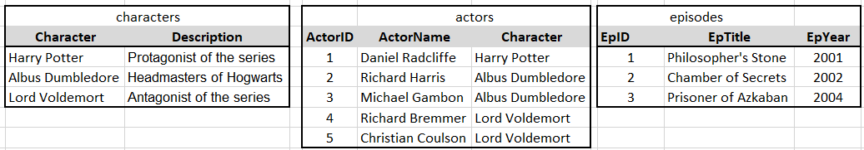
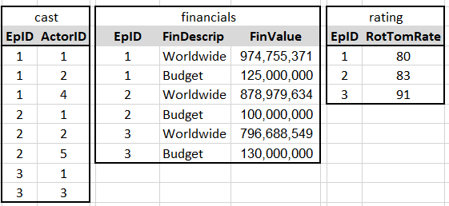
entities
Notes:
So here’s a modified version of our database design - it’s a bit cleaner. If I change actor name, I just do it in the actors table and nowhere else.
Is there anything else you think I should change?
Character ID
Financial ID
Now we have defined the entities, we can plan to store the data for each entity. So the tables might look something like this.
And just to say that this process of database design is going to be iterative. As you map out these different tables, you might find redundancy and decide to streamline your tables a bit more. The process is called normalization – and what we just did was an overview.
Sometimes you will have created your database and change it if necessary for performance reasons. You won’t know what the bottlenecks are until you start writing queries.
Ok, so now we have these tables, with the fields and attributes we want, there’s still something missing, how are these tables related to each other? How will we determine which actors were involved in Philosopher’s Stone, for instance? We need to define some relationships between them.
Do you think we can further split up these entities ?

Slide 27
Relationships
Relationships determine how entities are connected to each other.
The cardinality of a relationship determines how many relationships an entity can participate in.
One-to-one
One-to-many
Many-to-many
Notes:
So now that we have our entities, what’s missing? Relationships! We have to define how these tables are related to each other.
There are 3 types of relationships or – or how much of one side belongs to the other side – one to one, one to many, or many to many

Slide 28
Assigning Keys
A primary key (PK) is a unique identifier for an entity.
The foreign key (FK) is the reference to the primary key of another entity.
A composite key (CK) is a key that consist of two or more attributes.
Notes:
As mentioned earlier, we link tables together using keys. There are two main keys – PK and FK.
Keys are very important because it will help us identify a specific row in a current table, or refer to a specific row in another table.
PK –A PK is the unique identifier for a row of data. In order to act as a unique identifier, a column must contain some data, and that data should be unique to each row. Such as an ID column.
FK – A FK allows us to associate a row in one table to a row in another table. You set a column in one table as a foreign key and have a column reference another table’s PK column.
Episode ID can’t be a PK because one episode can have more than one actor.
Actor ID can’t be a PK because one actor can be in multiple episodes.
Hence, the key should have more than one attribute – episode ID and actor ID

Slide 29
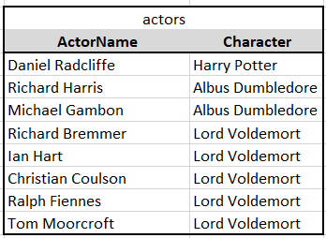
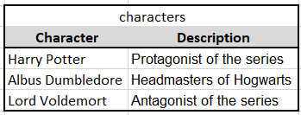
actors - characters
Notes:
Let’s take a look at 2 of our tables – actors and characters. The character column in the characters table is the PK because it uniquely identifies the characters. It’s a unique id for each description.
Meanwhile, the character column in actors is a foreign key because it serves as a reference to the character column of the characters table.
In our diagram, Harry Potter of our characters table is associated with Daniel Radcliffe in the actors table. Similarly, Albus Dumbledore is associated with Richard Harris and Michael Gambon. Lord Voldemort is associated with x, y, z. By setting up this reference table, we reduce redundancy.
What do you think is the FK
Do you think this is a one to one, one to many, or many to many?
One to many
Because? One character can be played by multiple actors
But multiple actors can only play one character.

Slide 30
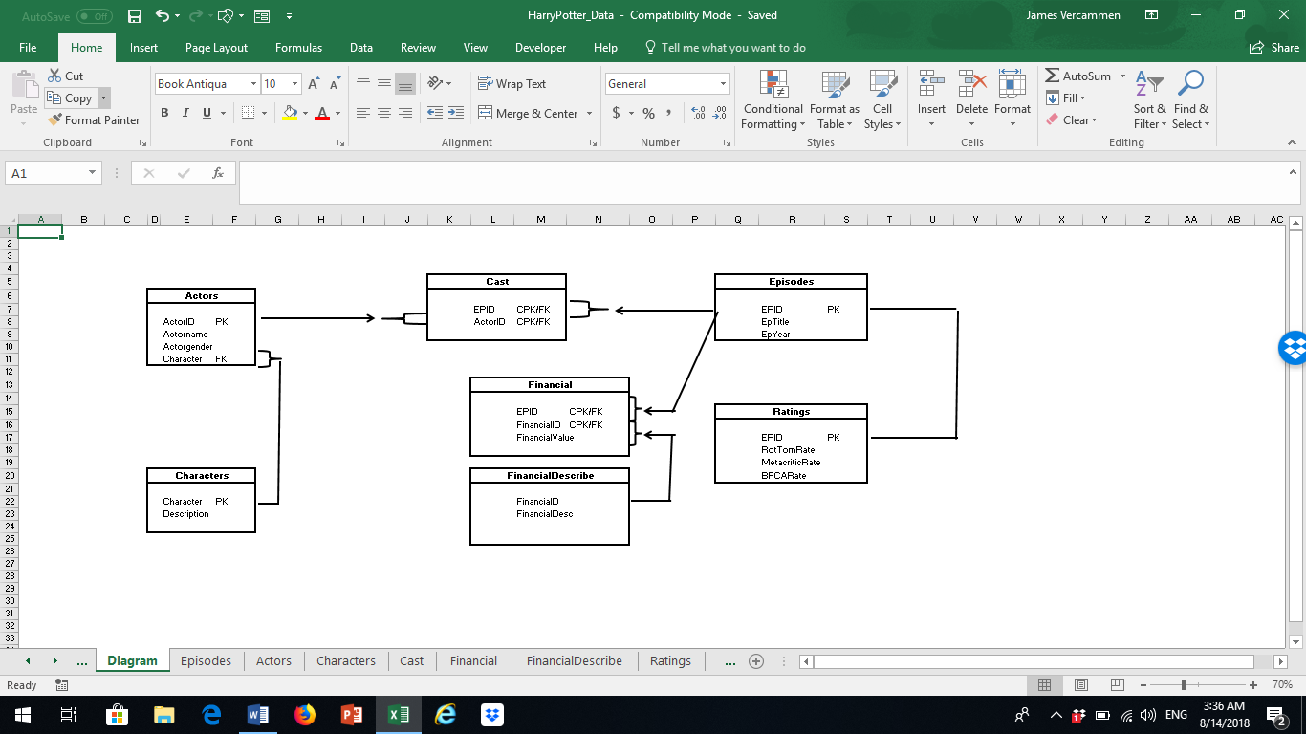
Notes:
So here’s an overview of the Harry Potter database. Dr. Vercammen created this database actually. And here we see all the different entities and how they are all related to each other. The entities were created as to reduce redundancy of data.
This diagram is also known as the “entity relationship diagram” which is basically a graphical representation of entities.
Database people call this as the “entity relationship diagram” – it is a graphical representation of entitites.

Slide 31
One-to-one
In a one-to-one relationship, there is a one-to-one mapping from one table to a second table
In the HP database, the relationship between episode and rating is one-to-one because there is a one-to-one mapping
In this case, the table’s PK also serves as the FK.
Notes:
In certain cases, it is easier to maintain one table for one-to-one relationships. Separate tables are warranted for data privacy reasons.
Separate tables are particularly valuable if different users of the db are updating different tables simultaneously.

Slide 32
One-to-many
One-to-many relationships are perhaps the most common in a relational database
In the HP database, there is a one-to-many relationship for the actors and characters entities.
The table on the “many” side of the equation has the FK, and the table on the “one” side has the PK (“pitchfork” diagram)
Notes:
A one to many relationship is the most common type of relationship, and justifies the use of separate tables in the database. As shown earlier, actors and characters have a one to many relationship. In different episodes, Lord Voldemort is played by different actors. However, each of these actors only played a single role.
Ning –one ingredient can be used for multiple items
Tianjian – one customer can buy several products
Specifically, each character has multiple actors. But each actor plays only one actor. In different episodes, Lord Valt is played by many people. However, each of these actors played only a single role. A particular character (Lord Voldemort) is played by more than one actor, but each actor plays just one character.
Diagram of pitchfork. One in the relationship. And the prongs point to the many in the relationship
The table on one side of the relationship has a primary key, but no foreign key
The table on the many side has a both a primary and foreign key.

Slide 33
One-to-many
Across the different episodes Lord Voldemort is played by:
Ian Hart, Richard Bremmer, Christian Coulson, Ralph Fiennes and Tom Moorcroft
Each of these actors only plays Lord Voldemort

Slide 34
Many-to-many
A many-to-many relationship requires a link/junction table
In the HP database, Episodes and Actors have a many-to-many relationship.
One actor can play in more than one episode. Each episode have more than one actor.
The PK is implicit since it is implied by the unique combination of the two FK.
Notes:
A M2M relationship are joined by a special connection table that does not have a traditional primary key. Rather this rel table contains 2 FK from a pair of tables that have a many to many relationship. PK is implicit in a connection table because each record has a unique combo of the two FK (or referred to as a composite foreign key).

Slide 35
Notes:
For example, the actor and episode database – 1 actor plays in more than 1 episode, and each episode have more than 1 actor. So there could be a many to many relationship here. This is why we have the cast table, it has no data, and its only function is to link the actors and the episodes together.
Another example of a many to many relationship in our database is the financial table. It is a linking table but it also contains data.

Slide 36
Recap
Understood the value of a database over a spreadsheet
Learned about basic database concepts including database design, entities, and relationships

